Slide 1


Wire Arc Additive Manufacturing
Multiaxis CNC Machines
By
Harsh Rana
Department of Mechanical Engineering
Indian Institute of Technology, Guwahati
Guwahati, Assam

Slide 2
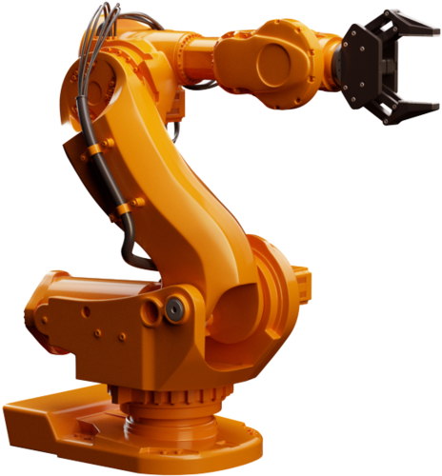
Multiaxis Machines
Machines having operatable tool that can move in 4 or more direction with the help of 4 or more independent axes.
Most common configurations are 3+1, 3+2, 4+1

Slide 3

Multiaxis Machines
Reasons to use
Shapes with complex contours : such as turbines, impellers, steering knuckles, etc.
Better Accuracy : as there is no need to move the workpiece from one fixture to another.
Reduced set up work : Most parts can be manufactured in 1 or 2 setups.
Better surface finishes : use of shorter tools – less tool deflection and less vibration. Tilting of tool can also help in cutting.
Increase efficiency : ability to do single setup machining offers significant business advantages.
Greater flexibility
High volume – low mix production : for workpieces manufactured in smaller but repeating volumes, i.e. the complex parts.

Slide 4
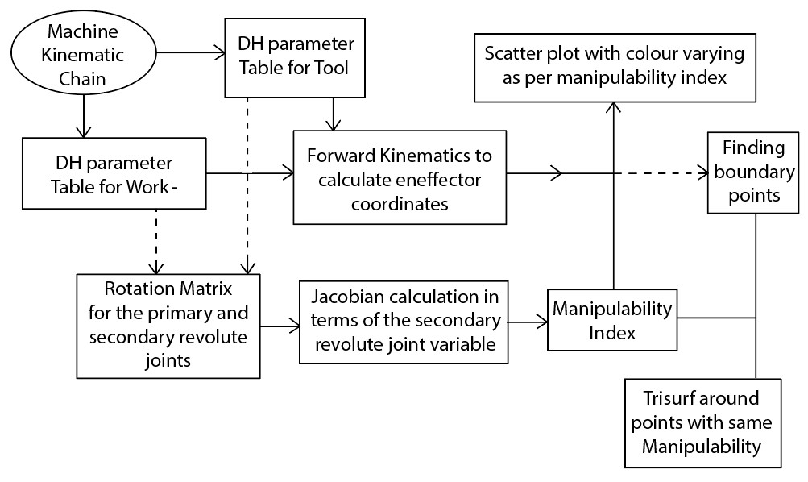
CNC Plotting
Flow chart

Slide 5
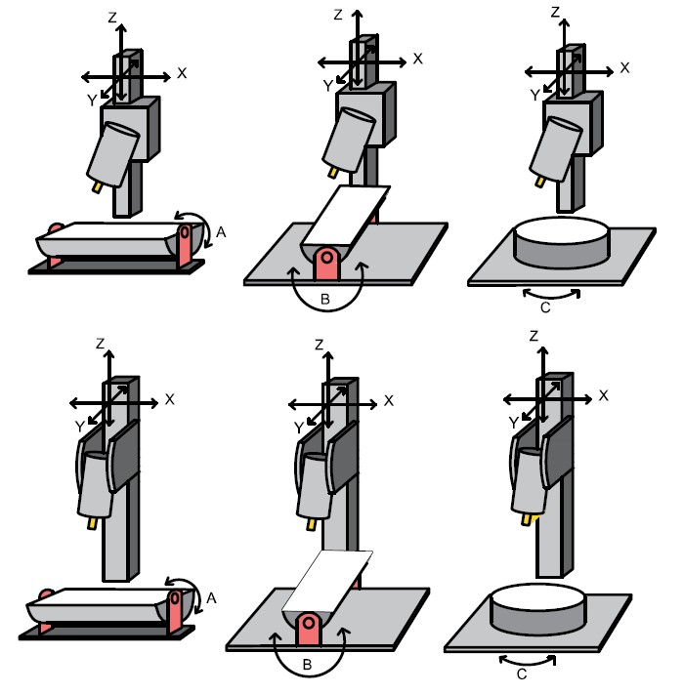
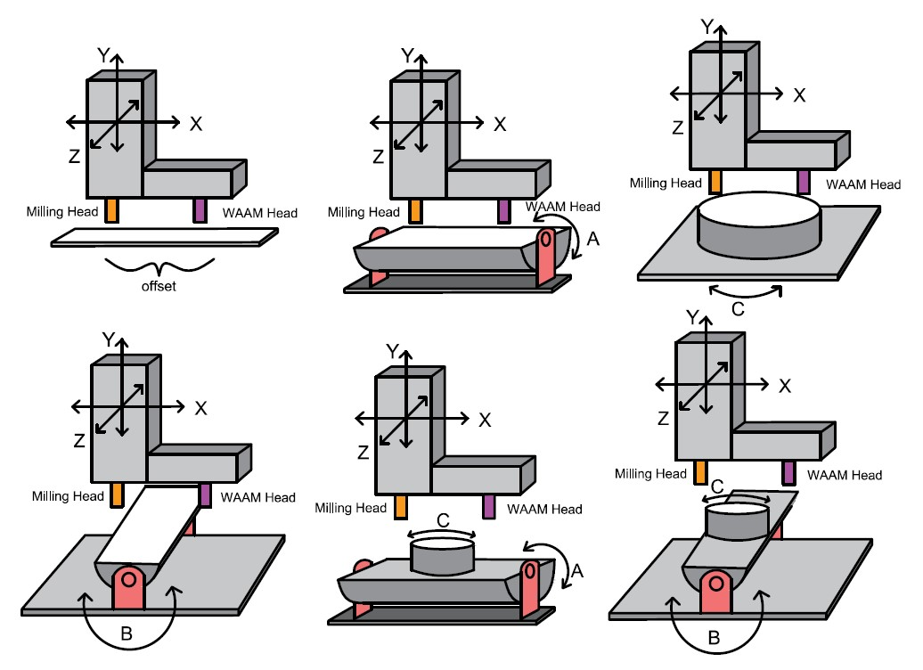
CNC Configurations

Slide 6
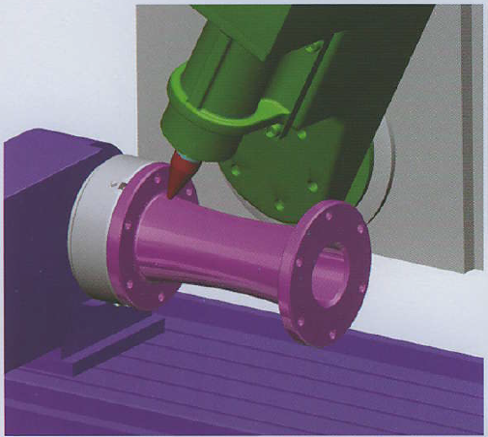
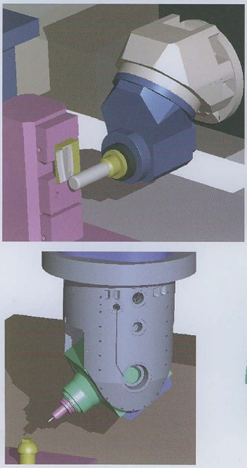
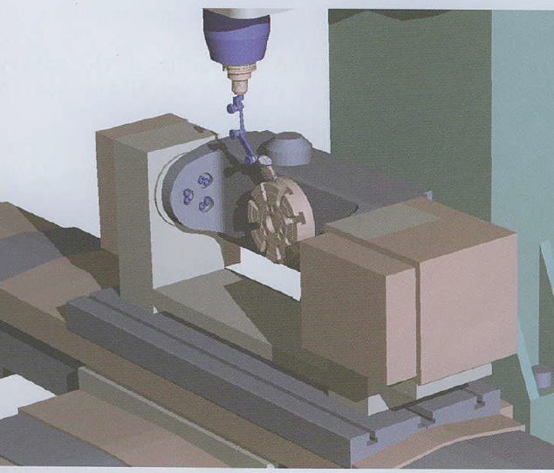
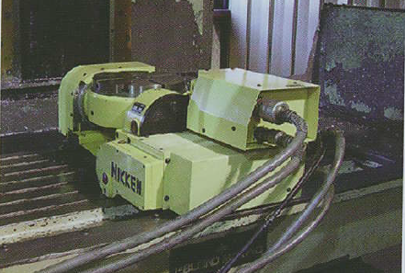
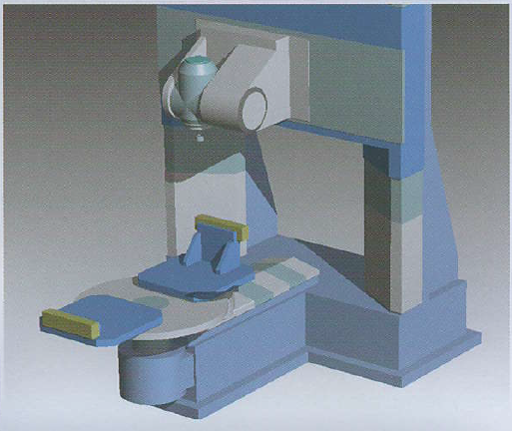
5 axis Configurations
Table/Table Multiaxis machines execute the rotary motions by the
dual rotary table, The primary rotary table carries the secondary
rotary table, which in turn carries the fixture and the part.
Head/Table Multiaxis machines execute the rotary motions by the
table, which carries the work piece, The spindle head articulates
the tool with tilting motions.
Head/Head Multiaxis machines execute all rotary/pivotang motions
by articulating the spindle head of the machine, The work piece is
stationary.

Slide 7
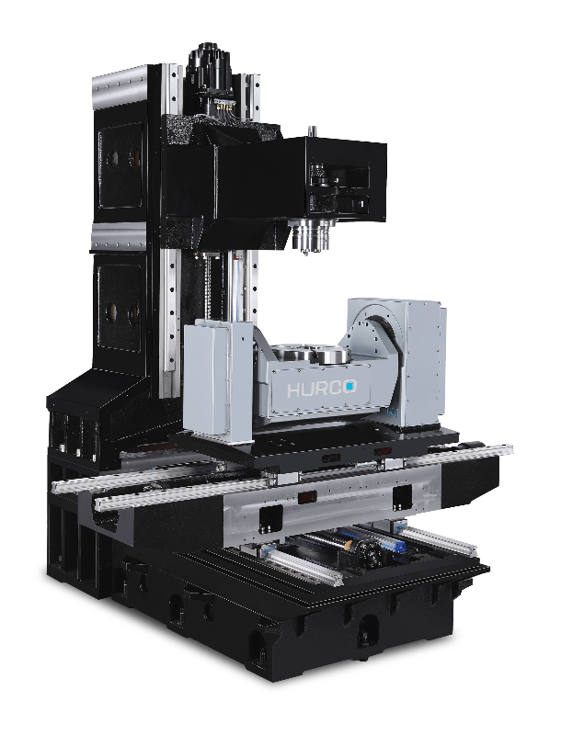
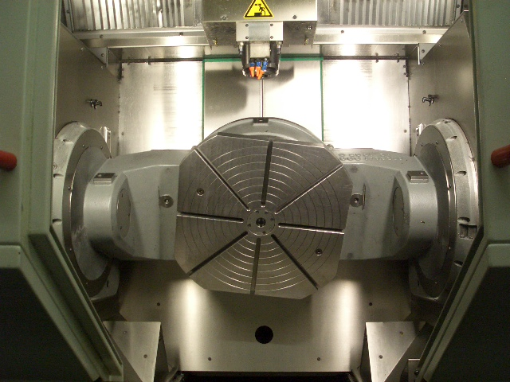
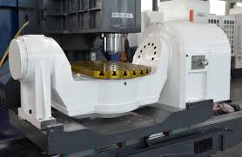
Table – Table Multiaxis Machines
Table/Table Multiaxis milling machines can be vertical or horizontal.
All the rotary motions except the spindle are done by the tables of these machines.
The main rotary table carries a second rotary table, to which is fastened the fixture and the part to be machined.
If the rotary axis are fixed, then this machine can be simply run as a 3 axis machine

Slide 8
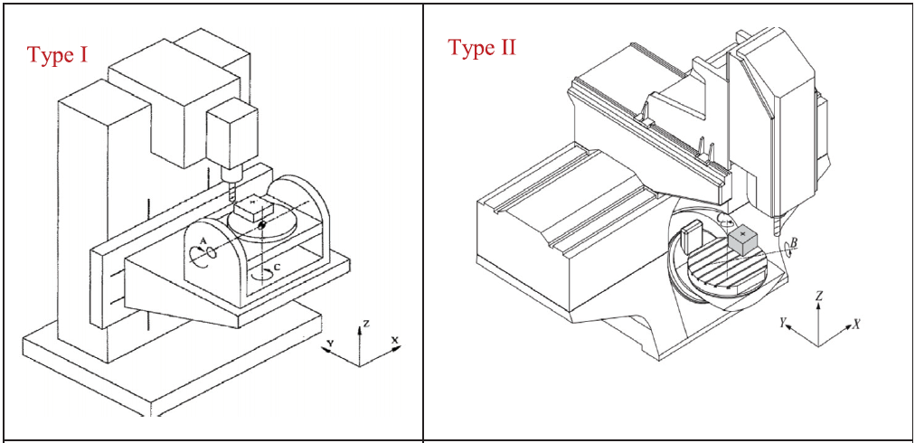
Table – Table Multiaxis Machines

Slide 9
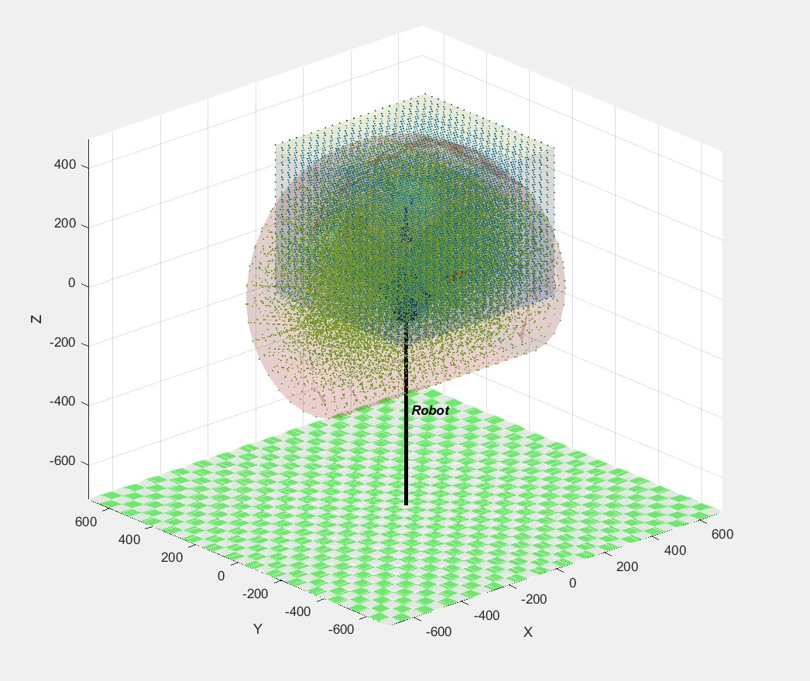

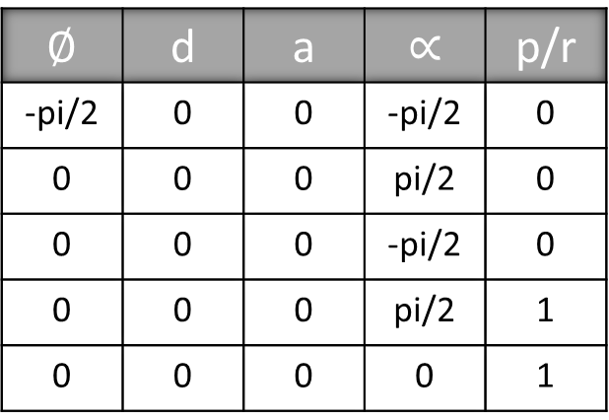
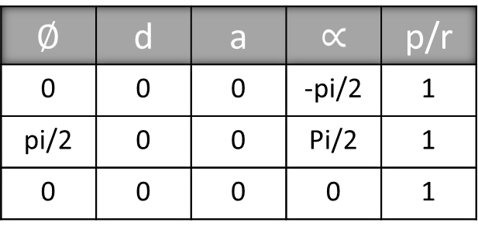
Trunnion Table
Swivel axis – A ; Rotary Table C
For PPP tool plot
$$∅$$ | d | a | $$∝$$ | p/r
0 | 0 | 0 | -pi/2 | 1
pi/2 | 0 | 0 | Pi/2 | 1
0 | 0 | 0 | 0 | 1
For Trunnion Table A axis
$$∅$$ | d | a | $$∝$$ | p/r
-pi/2 | 0 | 0 | -pi/2 | 0
0 | 0 | 0 | pi/2 | 0
0 | 0 | 0 | -pi/2 | 0
0 | 0 | 0 | pi/2 | 1
0 | 0 | 0 | 0 | 1

Slide 10
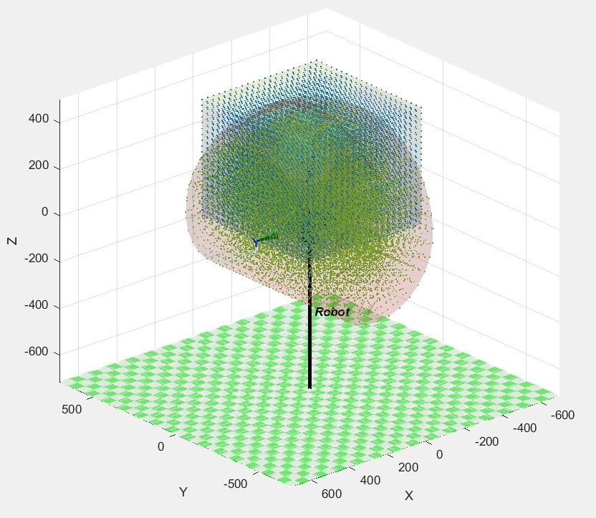
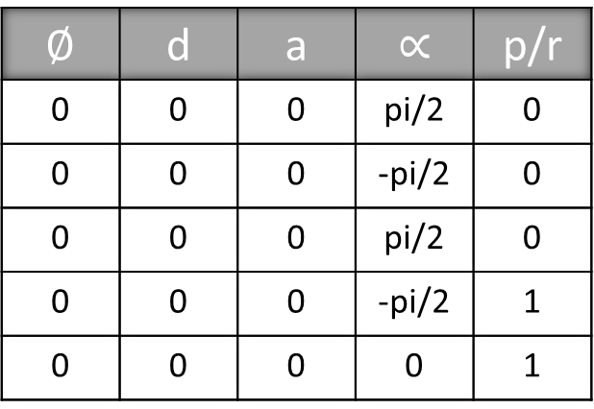
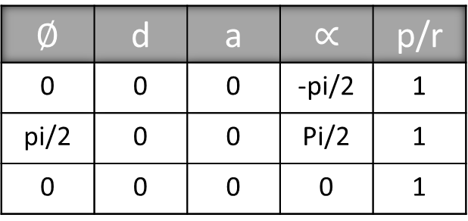
Trunnion Table
Swivel axis – B ; Rotary Table C
For PPP tool plot
$$∅$$ | d | a | $$∝$$ | p/r
0 | 0 | 0 | -pi/2 | 1
pi/2 | 0 | 0 | Pi/2 | 1
0 | 0 | 0 | 0 | 1
For Trunnion Table B axis
$$∅$$ | d | a | $$∝$$ | p/r
0 | 0 | 0 | pi/2 | 0
0 | 0 | 0 | -pi/2 | 0
0 | 0 | 0 | pi/2 | 0
0 | 0 | 0 | -pi/2 | 1
0 | 0 | 0 | 0 | 1

Slide 11
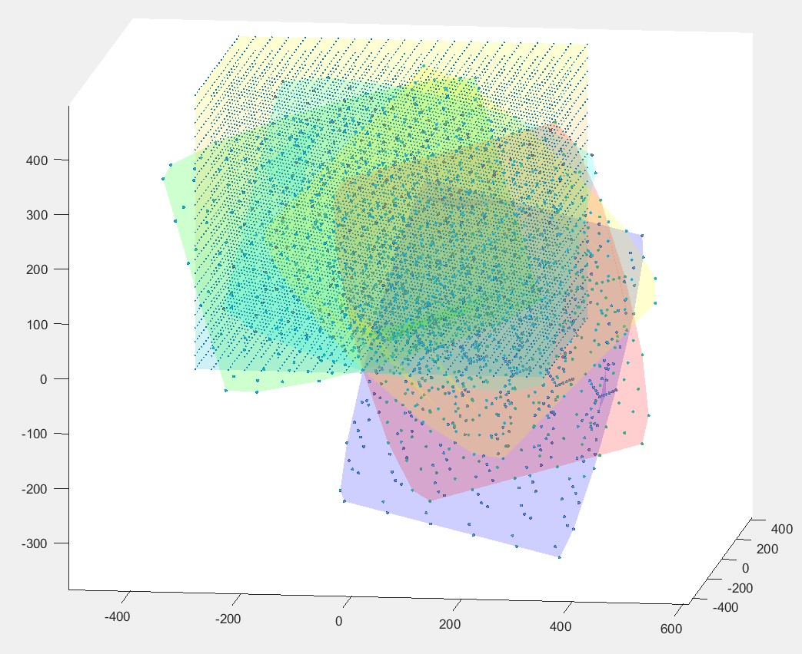
Trunnion Table
C -30 Hermle
Plot with Manipulability Index
A

Slide 12
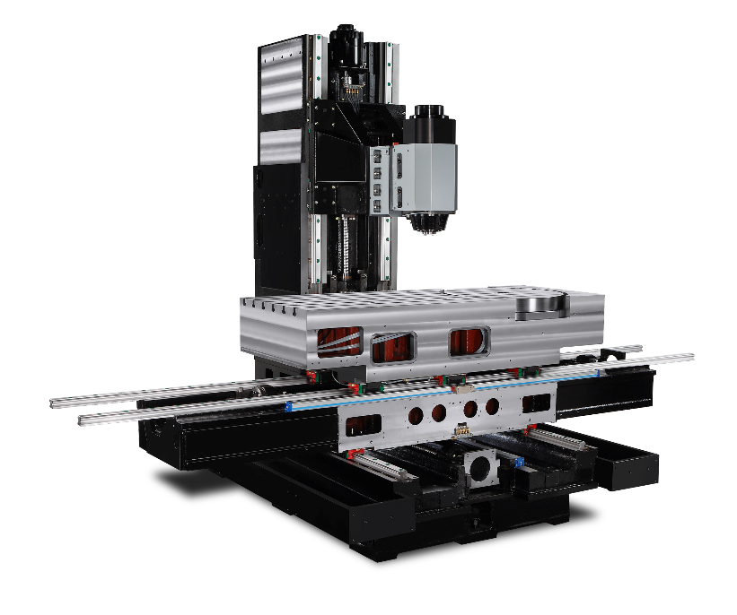
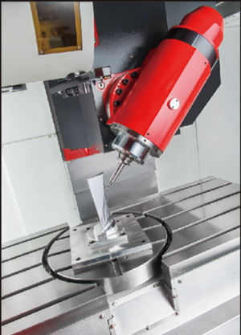
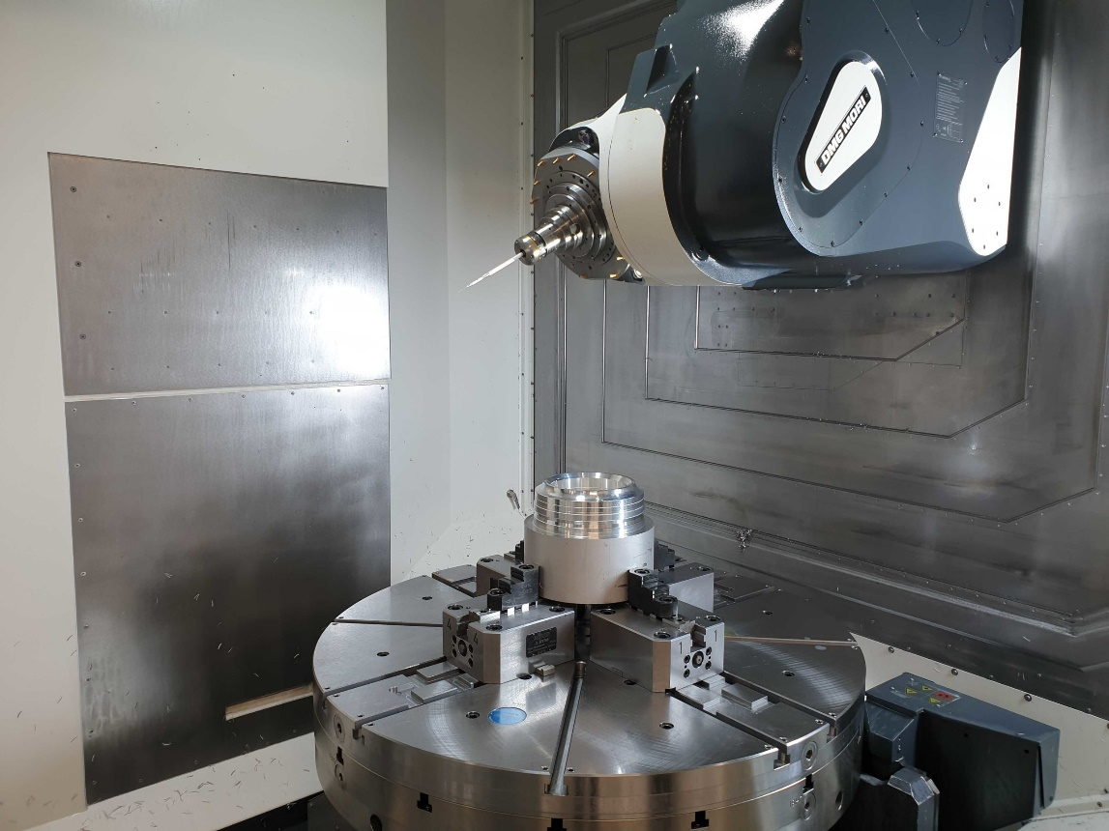
Head – Table Multiaxis Machines
Head-Table machines are arguably the most capable of the three groups.
They can machine large, heavy parts.
Suited for both indexing and simultaneous work.
Axis substitution also possible.

Slide 13
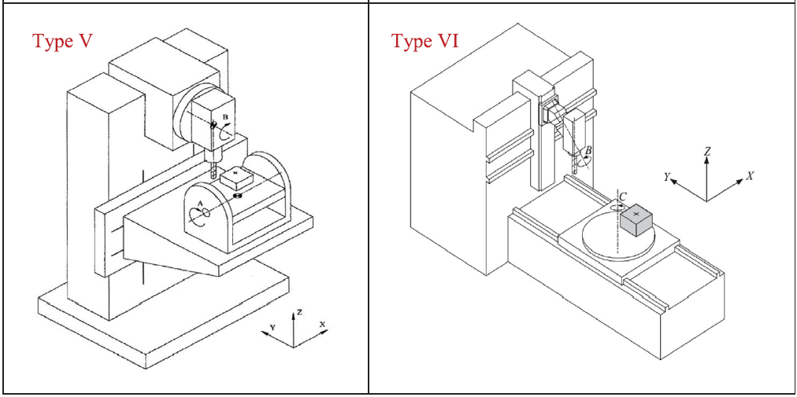
Head – Table Multiaxis Machines

Slide 14
CNC Configurations

Slide 15
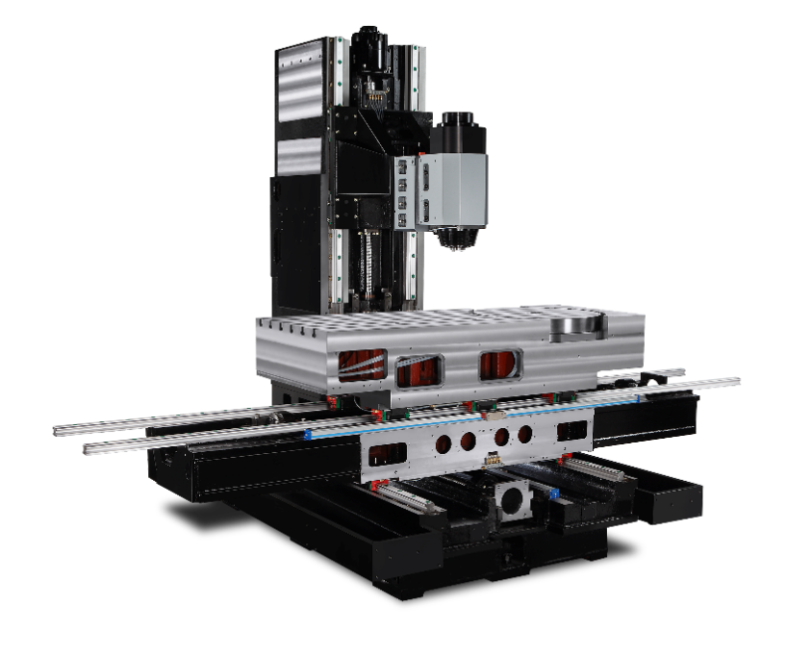
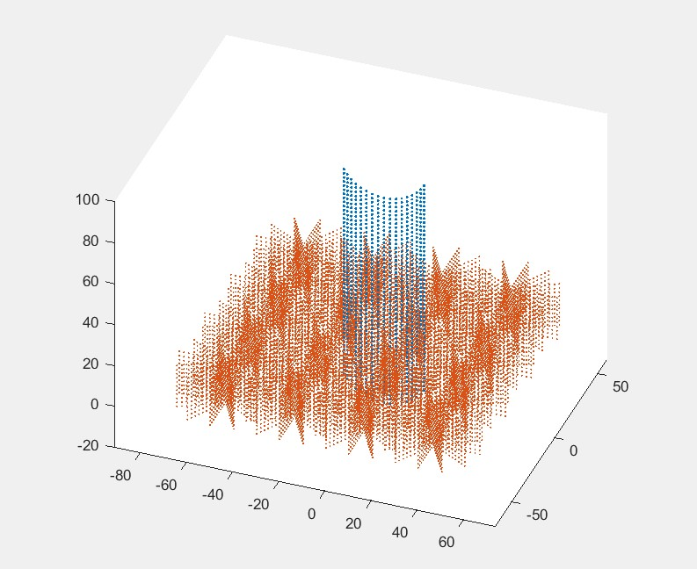
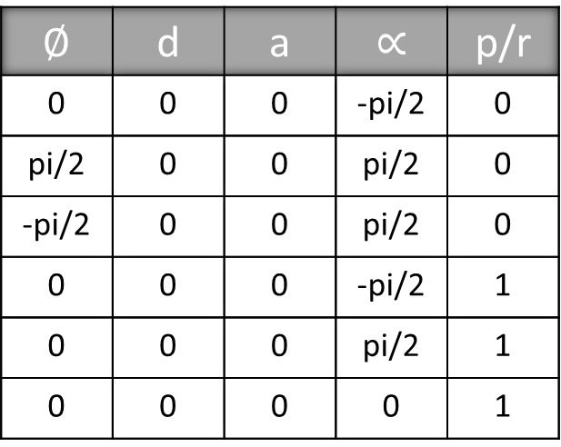
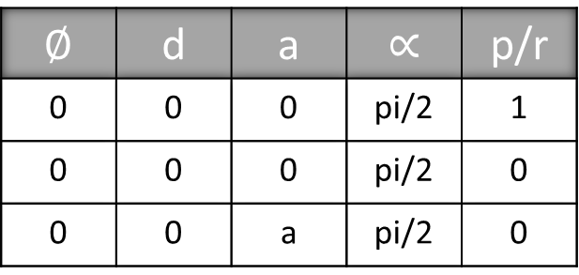
Swivel Head – Rotatory table
Swivel axis – B ; Rotatory axis C
For Swivel tool plot
$$∅$$ | d | a | $$∝$$ | p/r
0 | 0 | 0 | pi/2 | 1
0 | 0 | 0 | pi/2 | 0
0 | 0 | a | pi/2 | 0
For Table C, X, Y axes
$$∅$$ | d | a | $$∝$$ | p/r
0 | 0 | 0 | -pi/2 | 0
pi/2 | 0 | 0 | pi/2 | 0
-pi/2 | 0 | 0 | pi/2 | 0
0 | 0 | 0 | -pi/2 | 1
0 | 0 | 0 | pi/2 | 1
0 | 0 | 0 | 0 | 1

Slide 16
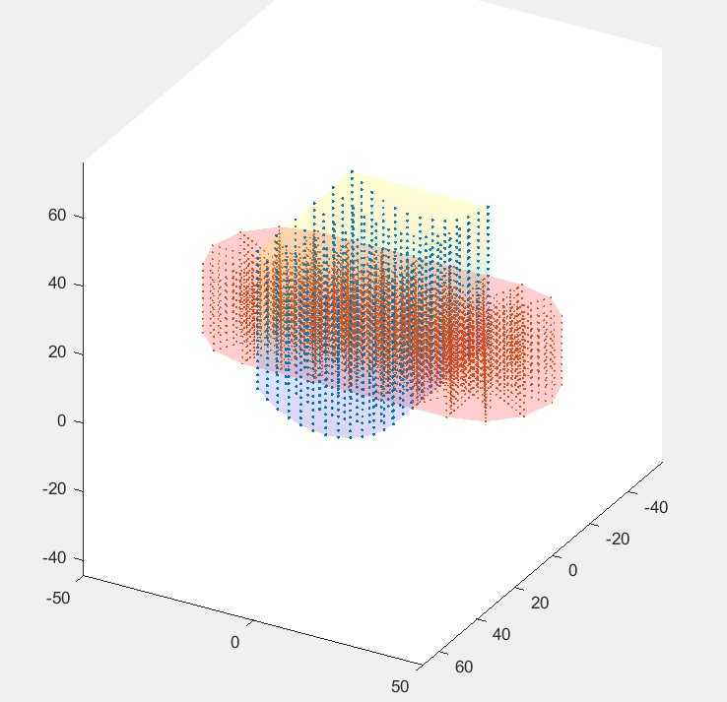
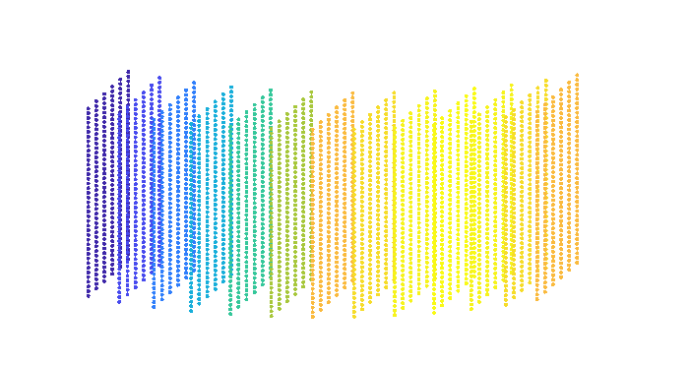
Swivel Head – Rotatory table
Swivel axis – B ; Rotatory axis C
Plot, if one translatory axis was shifted to the top
With manipulability it the tool plot would look like this
Manipulability colours can be got only in the section of the plot where the secondary revolute joint variable plays a role. As mew is only dependent on qv

Slide 17
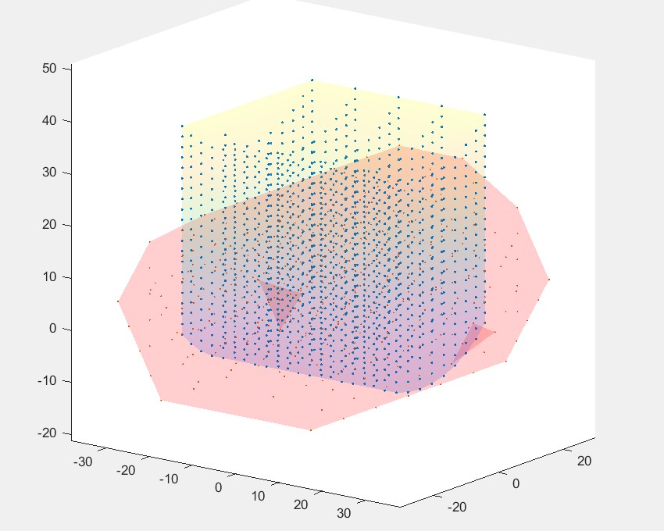
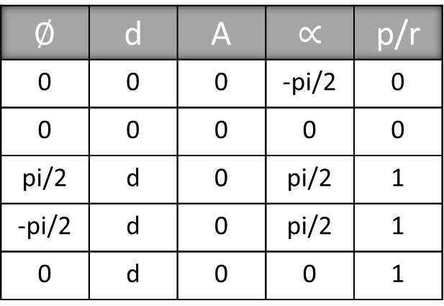
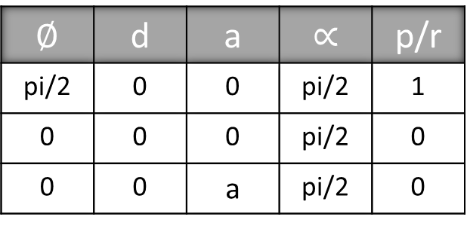
Swivel Head – Rotatory table
Swivel axis – B ; Rotatory axis A
For Swivel tool plot
$$∅$$ | d | a | $$∝$$ | p/r
pi/2 | 0 | 0 | pi/2 | 1
0 | 0 | 0 | pi/2 | 0
0 | 0 | a | pi/2 | 0
For Table C, X, Y axes
$$∅$$ | d | A | $$∝$$ | p/r
0 | 0 | 0 | -pi/2 | 0
0 | 0 | 0 | 0 | 0
pi/2 | d | 0 | pi/2 | 1
-pi/2 | d | 0 | pi/2 | 1
0 | d | 0 | 0 | 1

Slide 18
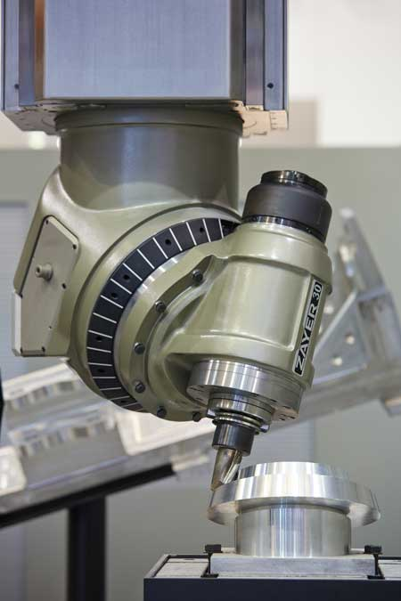
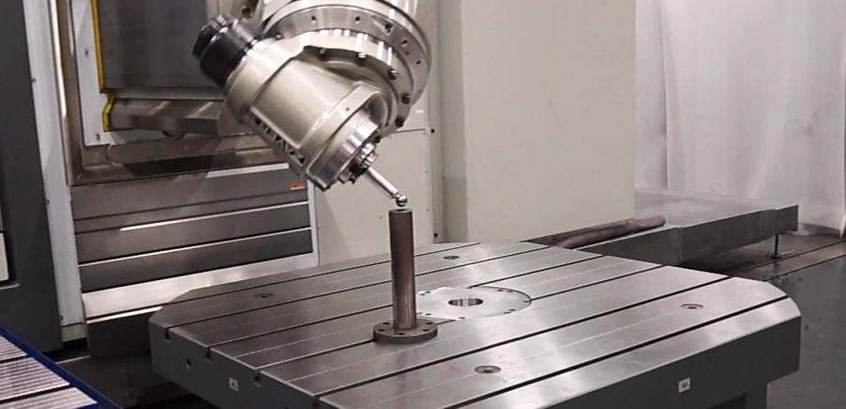
Head – Head Multiaxis Machines
All the Rotary/Pivoting motions are executed by the spindle head of the machine.
Heads can be straight, 90degree, nutating, or continuously indexing.

Slide 19
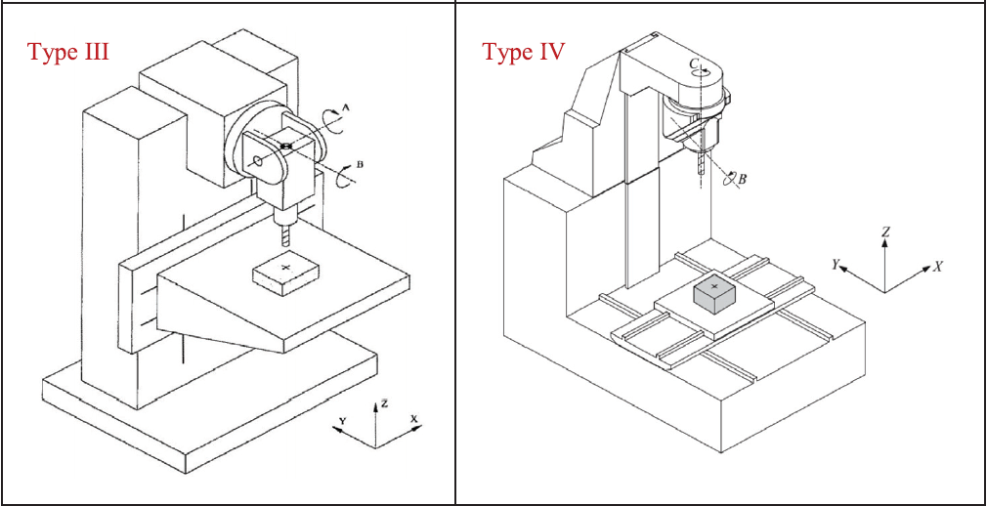
Head – Table Multiaxis Machines

Slide 20
Thank You
Harsh Rana
BTech: Mechanical Engineering
Email: harsh.ajay@iitg.ac.in
Mobile Number: 9773102188
Department of Mechanical Engineering
Indian Institute of Technology, Guwahati
Guwahati, Assam

Slide 21
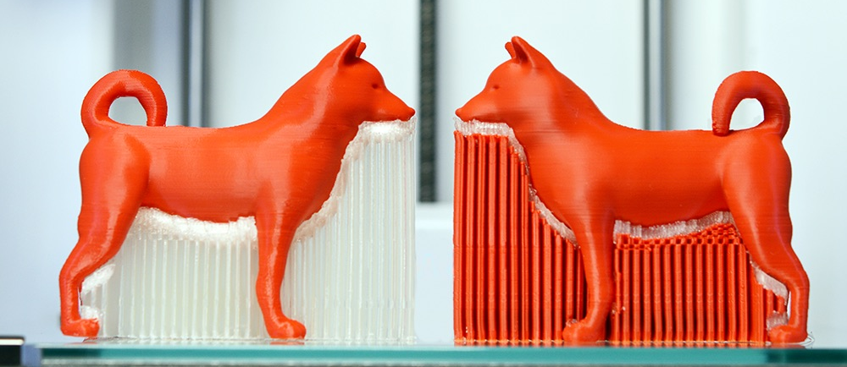
Support Structure

Slide 22
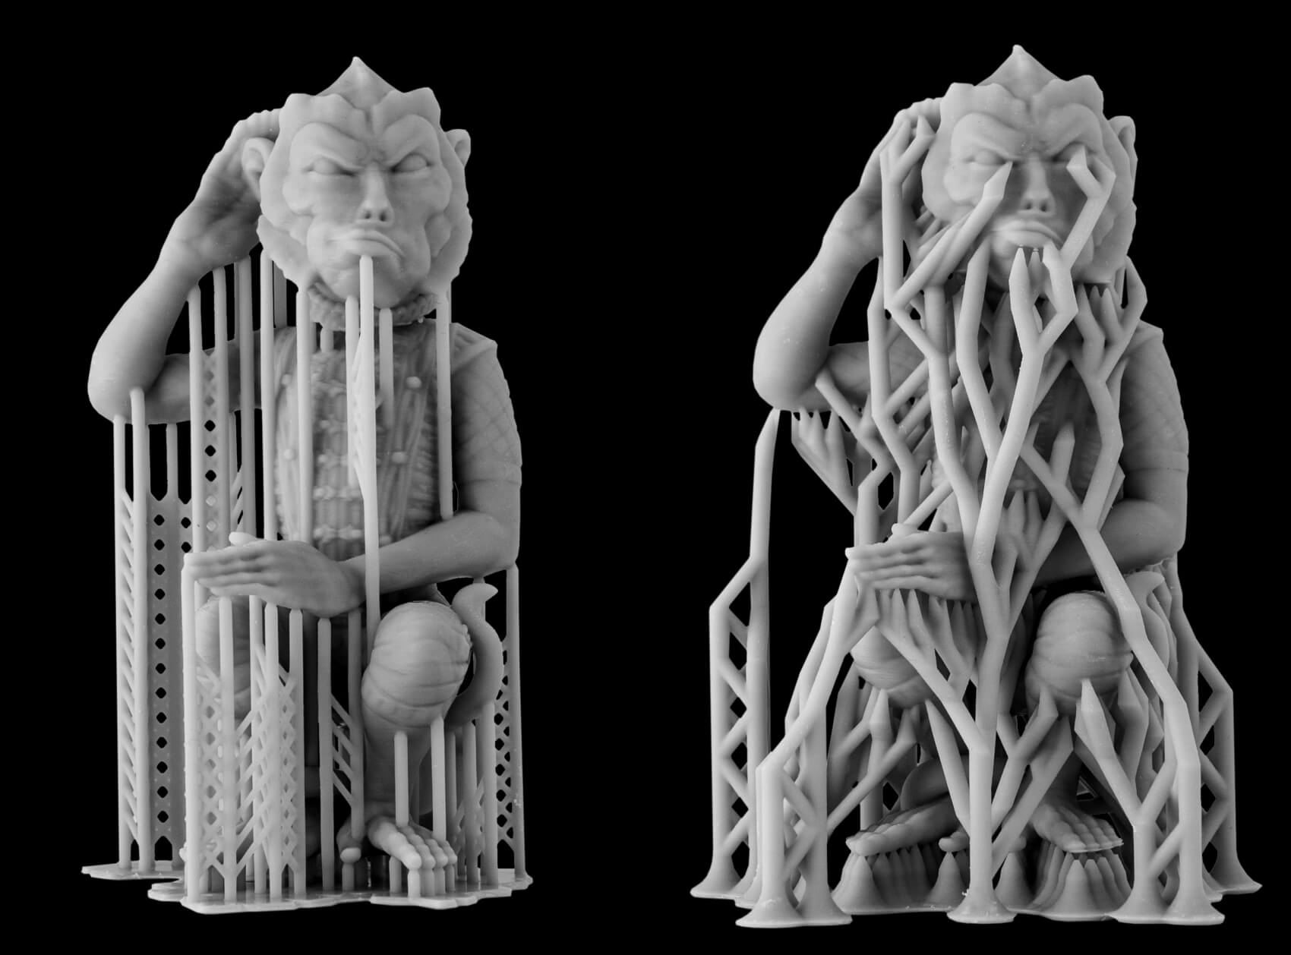
Support Structure

Slide 23
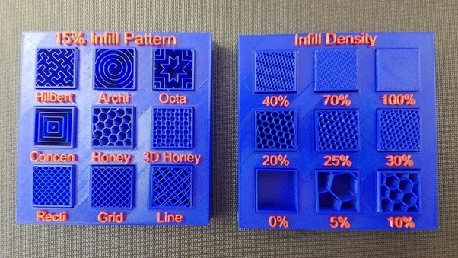
Infill

Slide 24
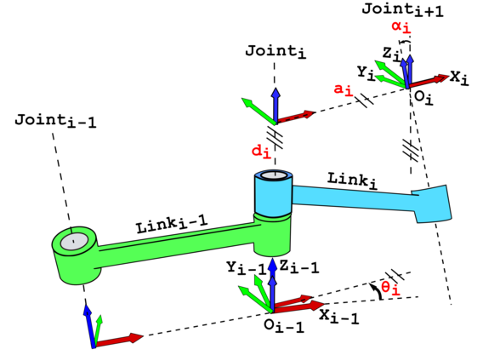
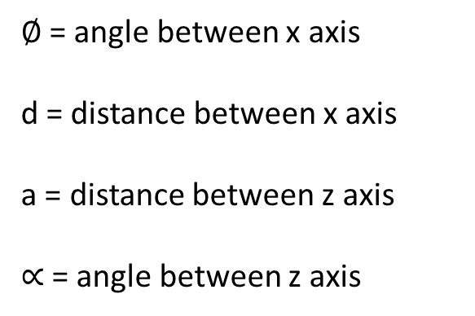
DH Parameters
$∅$= angle between x axis
d = distance between x axis
a = distance between z axis
$∝$= angle between z axis

Slide 25
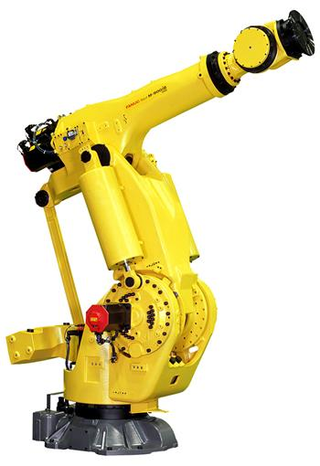
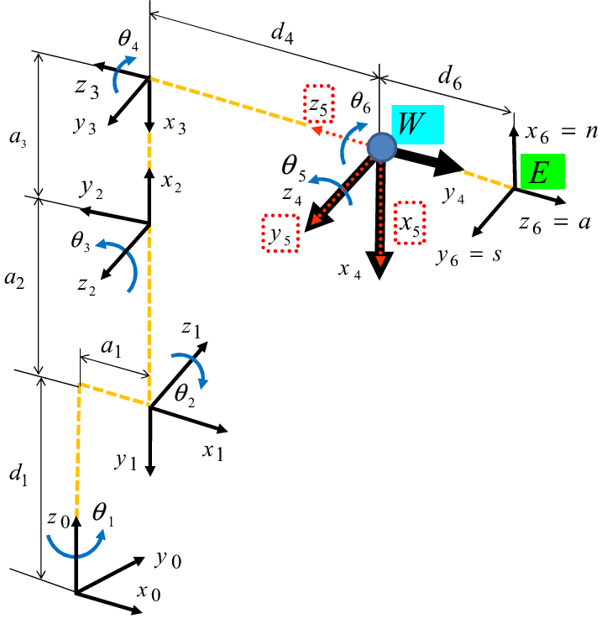
Kinematic Chain

Slide 26
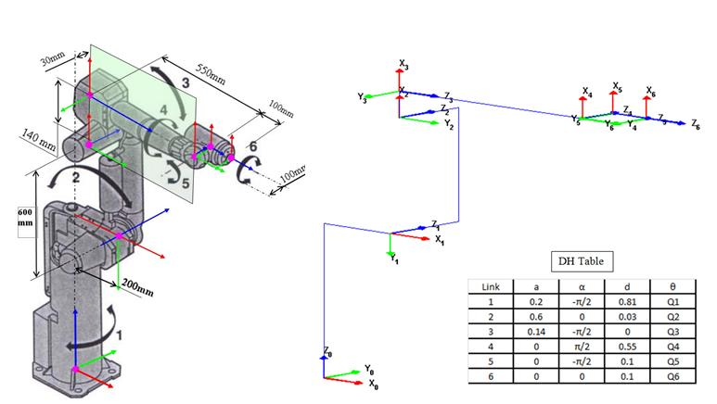
DH Parameters

Slide 27
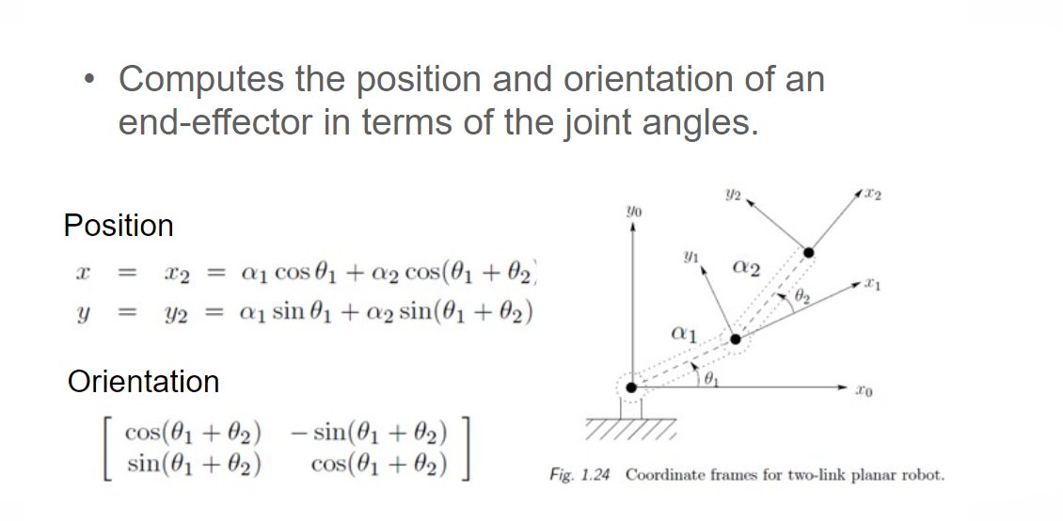
Forward Kinematics

Slide 28
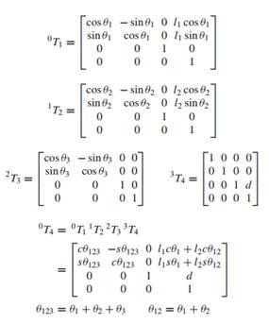
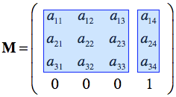
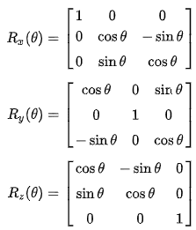
Transformation Matrix

Slide 29
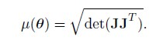
Manipulability Index
The manipulability index of given robot poses, introduced by Yoshikawa in 1985, can be calculated as a quality value that gives information about how good an adjustment in workspace is possible.
Manipulability Index: (by T. Yoshikawa)
The manipulability measure based on the Jacobian matrix, J, is defined as:
The purpose of manipulability indices is to give a quantitative measure of the ability to move and apply forces in arbitrary directions.
Larger values of mew represent greater freedom for the specific configuration.
The manipulability measure provides a measure of the product of the eigenvalues of JJ^{T}.

Slide 30
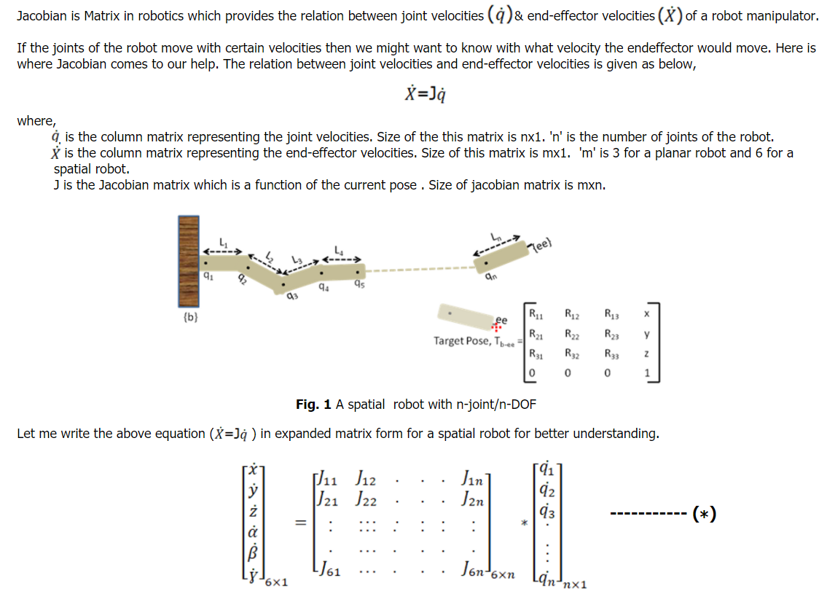
Jacobian

